Slide 1


Thelook Growth Inventory and Cohort Analysis
Lidia Puspa Ningtyas
March 14th, 2024
Linkedin - https://www.linkedin.com/in/lidia-p/

Slide 2

Business Overview & Disclaimer
Company Overview: Thelook
TheLook is a fictitious eCommerce clothing site developed by the Looker team operating in a highly competitive online market. With a commitment to innovation and customer satisfaction, the company leverages data to stay ahead of trends and consumer demands.
By utilizing data-driven insights, TheLook continuously monitors inventory growth trends and customer retention patterns to optimize stock management and enhance long-term customer engagement. Analyzing monthly inventory growth helps the company ensure efficient supply chain operations, while tracking customer retention enables it to refine marketing and loyalty strategies. These data-driven approaches support sustainable business growth and strengthen TheLook's competitive position in the e-commerce market
Disclaimer
The dataset contains information about customers, products, orders, logistics, web events,
and digital marketing campaigns. The contents of this dataset are synthetic and are provided to industry practitioners for the purpose of product discovery, testing, and evaluation.

Slide 3
Project Goals
Identify monthly growth of inventory in percentage breakdown by product categories,
Analyze monthly growth of inventory in percentage breakdown ordered by time descendingly.
Segment customers into monthly cohorts based on the groups, or cohorts, can be defined based upon the date that a user completely purchased a product.
Measure retention rates (%) for each cohort over the months of 2022.

Slide 4
Methodology
1
Business Understanding
Company overview & project goals
﻿﻿Understand dataset overview and potential relationships between data.
﻿﻿Understand the business question and how to answer the question.
2
Data Extraction & Transformation
Using SQL (Google BigQuery) to query and transform the data from TheLook’s tables
3
Analysis & Insights
For each analysis, include:
﻿﻿Query Explanation
﻿﻿Formatted SQL Query
﻿﻿Screenshot of Query Output
Insight
Link query: Thelook query

Slide 5
Dataset Overview
No. | Tables | Primary Key | Foreign Key | Remarks for Foreign Key
1. | inventory_items | id | product_id | Related to products field (id)
 |  |  | product_distribution_center_id | Related to distribution_centers field (id)
2. | products | id | distribution_center_id | Related to distribution_centers field (id)
3. | distribution_centers | id
4. | order_items | id | order_id | Related to orders field (order_id)
 |  |  | user_id | Related to users field (id)
 |  |  | product_id | Related to products field (id)
 |  |  | invetory_item_id | Related to inventory_items field (id)
5. | orders | order_id | user_id | Related to users field (id)
6. | users | id
7. | events | id | user_id | Related to users field (id)

Slide 6
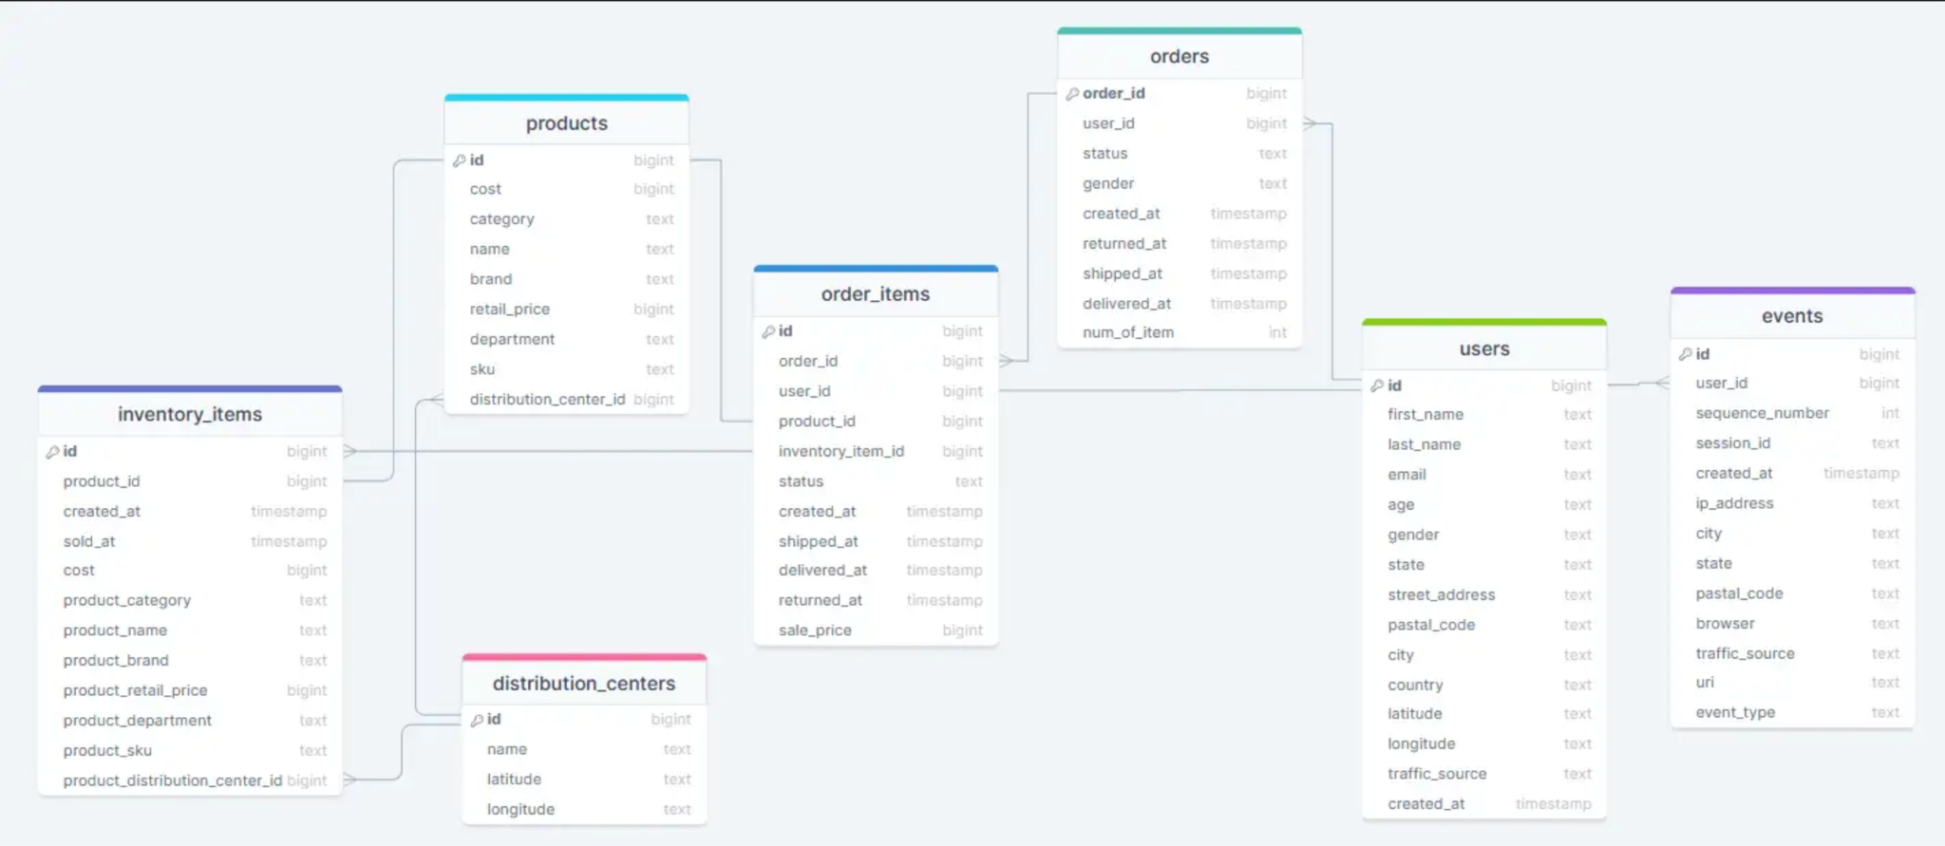
ERD Thelook Dataset

Slide 7

Monthly Growth Inventory (1/2)
find monthly growth of inventory in percentage breakdown by product categories, ordered by time descendingly
SQL Query
Hypothesis
Alpha
Statistical Test
Kriteria Keputusan
Kesimpulan
Insight bisnis
-- To support the business, find monthly growth of inventory in percentage breakdown by product categories, ordered by time descendingly.
WITH monthly_inventory AS(
SELECT
product_category
,FORMAT_DATE('%Y-%m', created_at) AS year_month
,COUNT (id) AS stock
FROM fsda-sql-01.TheLook_Ecommerce.inventory_items AS inventory
GROUP BY 1,2
),
previous_monthly_inventory AS (
SELECT
product_category
,year_month
,stock
,LAG(stock) OVER (PARTITION BY product_category ORDER BY year_month) AS prev_month_stock
FROM monthly_inventory
)
SELECT
year_month
,product_category
,stock
,prev_month_stock
,ROUND((((stock - prev_month_stock)/ prev_month_stock)*100),2) AS percentage_growth_inventory
FROM previous_monthly_inventory
ORDER BY 2 ASC, 1 DESC;
We used the inventory_items table and performed the following steps:
CTE 1: monthly_inventory – In this table, we calculate the total product stock per category, aggregated by month.
CTE 2: previous_monthly_inventory – In this table, we calculate the total product stock per category for the previous month using the LAG function.
Finally, in the main query, we calculate inventory growth by subtracting the previous month's stock from the current month's stock, then dividing by the previous month's stock and converting the result into a percentage.

Slide 8
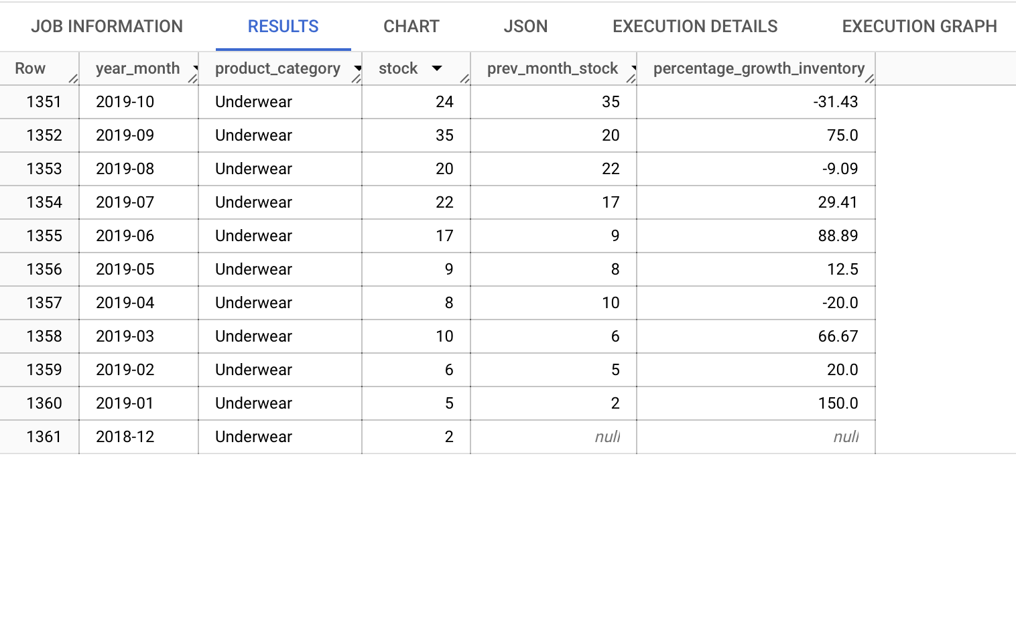
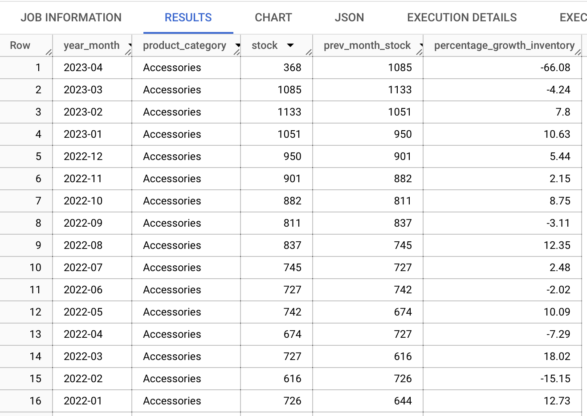
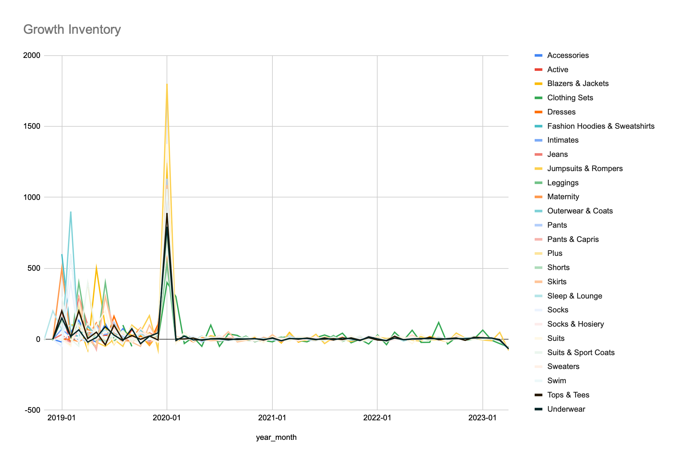
Monthly Growth Inventory (2/2)
find monthly growth of inventory in percentage breakdown by product categories, ordered by time descendingly
Query Output
Hypothesis
Alpha
Statistical Test
Kriteria Keputusan
Kesimpulan
Insight bisnis
Insight
There was a major spike around January 2020, where several categories experienced a drastic increase in inventory, reaching almost 2,000 units. The highest spike during this period occurred in the Jumpsuits & Rompers category.
After the huge spike in early 2020, inventory growth became much more stable from mid-2020 to 2023.
Before 2020, some categories, such as Outerwear & Coats, showed high fluctuations in inventory levels.
Blazers & Jackets and Outerwear & Coats experienced the highest inventory surge, which may indicate seasonal demand or a major shift in inventory strategy for these categories.

Slide 9
Monthly Retention Cohorts (1/2)
How many of them (%) coming back for the following months in 2022?
SQL Query
-- Create monthly retention cohorts and then how many of them (%) coming back for the following months in 2022
WITH cohort_items AS(
SELECT DISTINCT
orders.user_id AS user_id
,MIN(DATE_TRUNC(DATE(orders.created_at),MONTH)) OVER (PARTITION BY orders.user_id) AS first_order_date
,DATE_TRUNC(DATE(orders.created_at),MONTH) AS running_order_date
FROM fsda-sql-01.TheLook_Ecommerce.order_items AS orders
WHERE status = 'Complete'
ORDER BY 1
),
user_period AS(
SELECT
*
,DATE_DIFF(running_order_date,first_order_date, MONTH) AS diff_month
,COUNT(DISTINCT user_id) OVER (PARTITION BY first_order_date) AS cohort_size
FROM cohort_items
),
total_user_retention AS (
SELECT
first_order_date
,diff_month AS month
,cohort_size
,COUNT (DISTINCT user_id ) AS total_user
FROM user_period
WHERE first_order_date BETWEEN '2022-01-01' AND '2022-12-01'
AND running_order_date <='2022-12-01'
GROUP BY 1,2,3
ORDER BY 1,2
),
retention AS(
SELECT
*
,ROUND(((total_user/cohort_size)*100),2) AS retention_rate
FROM total_user_retention
ORDER BY first_order_date, total_user DESC
)
SELECT
first_order_date
,MAX (total_user) AS total_users
,MAX(CASE WHEN month = 0 THEN retention_rate END) AS month_0
,MAX(CASE WHEN month = 1 THEN retention_rate END) AS month_1
,MAX(CASE WHEN month = 2 THEN retention_rate END) AS month_2
,MAX(CASE WHEN month = 3 THEN retention_rate END) AS month_3
,MAX(CASE WHEN month = 4 THEN retention_rate END) AS month_4
,MAX(CASE WHEN month = 5 THEN retention_rate END) AS month_5
,MAX(CASE WHEN month = 6 THEN retention_rate END) AS month_6
,MAX(CASE WHEN month = 7 THEN retention_rate END) AS month_7
,MAX(CASE WHEN month = 8 THEN retention_rate END) AS month_8
,MAX(CASE WHEN month = 9 THEN retention_rate END) AS month_9
,MAX(CASE WHEN month = 10 THEN retention_rate END) AS month_10
,MAX(CASE WHEN month = 11 THEN retention_rate END) AS month_11
,MAX(CASE WHEN month = 12 THEN retention_rate END) AS month_12
FROM retention
GROUP BY 1
ORDER BY 1;
Hypothesis
Alpha
Statistical Test
Kriteria Keputusan
Kesimpulan
Insight bisnis
We used the orders_items table and performed the following steps:
CTE 1: cohort_items - This Common Table Expression (CTE) retrieves the first order date and running order date for each user.It only includes orders where the status is 'Complete' to ensure we analyze actual purchases.
CTE 2: user_period - This CTE calculates the difference in months between the user's first order and subsequent orders to determine how long they remain active. It also counts the unique user IDs based on their first order date to obtain the cohort size (i.e., the total number of users in each cohort).
CTE 3: total_user_retention - This CTE counts the total number of unique users who made a repeat purchase in each period. The results are grouped by first order date and the number of months since the first purchase (diff_month) to track retention trends.
CTE 4: retention - This CTE calculates the retention rate for each month by dividing the number of retained users by the initial cohort size. The results are expressed as percentages to show retention trends over time.
Finally, in the main query, we create a pivot table using the CASE function to visualize the cohort analysis results, displaying retention rates across different months.

Slide 10
Monthly Retention Cohorts (2/2)
How many of them (%) coming back for the following months in 2022?
Query Output
first_order_date | total_users | month_0 | month_1 | month_2 | month_3 | month_4 | month_5 | month_6 | month_7 | month_8 | month_9 | month_10 | month_11 | month_12
01/01/22 | 670 | 100 | 2.39 | 1.34 | 1.34 | 1.34 | 0.45 | 0.6 | 0.9 | 1.04 | 1.64 | 0.75 | 0.75
01/02/22 | 600 | 100 | 3.83 | 1 | 0.5 | 0.83 | 1 | 0.83 | 1.67 | 1.5 | 1.17 | 1.5
01/03/22 | 735 | 100 | 3.13 | 1.22 | 0.68 | 1.09 | 1.77 | 0.82 | 0.68 | 1.09 | 0.82
01/04/22 | 774 | 100 | 2.45 | 1.29 | 2.07 | 0.9 | 0.39 | 1.29 | 1.42 | 1.29
01/05/22 | 853 | 100 | 3.63 | 1.29 | 1.17 | 1.06 | 1.17 | 0.94 | 1.06
01/06/22 | 795 | 100 | 2.89 | 1.01 | 2.14 | 1.38 | 1.26 | 0.88
01/07/22 | 943 | 100 | 2.44 | 1.06 | 1.38 | 1.8 | 1.8
01/08/22 | 974 | 100 | 2.26 | 1.54 | 1.03 | 2.05
01/09/22 | 1020 | 100 | 3.82 | 2.45 | 2.65
01/10/22 | 1121 | 100 | 3.93 | 1.52
01/11/22 | 1219 | 100 | 4.35
01/12/22 | 1329 | 100
Hypothesis
Alpha
Statistical Test
Kriteria Keputusan
Kesimpulan
Insight bisnis
Insight
Retention drops significantly after month_1, indicating that a large portion of users do not return after their first purchase.
Some cohorts show slight increases in retention in later months (e.g., month_3 or month_4), which could suggest seasonal effects or successful re-engagement efforts such as promotions, emails, or ads.
By month_5 or later, retention falls below 2% for most cohorts.
By month_9-12, nearly all cohorts lose their users, highlighting weak long-term engagement.
The total number of users has been growing over time (670 users in Jan 2022 → 1,329 users in Dec 2022).
However, retention rates have not improved significantly, suggesting that while more new users are joining, they are not converting into loyal customers.

Slide 11
Summary
Inventory Growth Insights
Major spike in January 2020, with inventory surging to nearly 2,000 units, especially in Jumpsuits & Rompers.
After early 2020, inventory growth stabilized from mid-2020 to 2023.
Outerwear & Coats showed high fluctuations before 2020.
Blazers & Jackets and Outerwear & Coats had the highest inventory surges, possibly due to seasonal demand or inventory strategy shifts.
Retention Analysis
Sharp drop in retention after month 1, indicating that most users do not return after their first purchase.
Slight retention increases in months 3–4 in some cohorts, suggesting seasonal effects or successful re-engagement (e.g., promotions, emails, ads).
By month 5, retention falls below 2%, and by months 9–12, most cohorts lose their users, highlighting weak long-term engagement.
Total users increased from 670 (Jan 2022) to 1,329 (Dec 2022), but retention rates remain low, indicating that new users are not converting into loyal customers.
Key Business Recommendations
Enhance customer retention through loyalty programs, better onboarding, and personalized engagement.
Leverage targeted marketing to encourage repeat purchases and long-term retention.
Optimize inventory strategy by aligning stock levels with demand trends to prevent excess inventory spikes.

Slide 12

THANK YOU

